Slide 1



PGR-led 1-day R programming Workshop –
Part II: Data Visualizations & Inferential Statistics
Presenter: Peter To (3rd Year Psychology PhD Student, University of Warwick)
Date: 13th June (Friday) 2025
Time: 11:45 – 12:15, 13:30 – 14:30

Slide 2

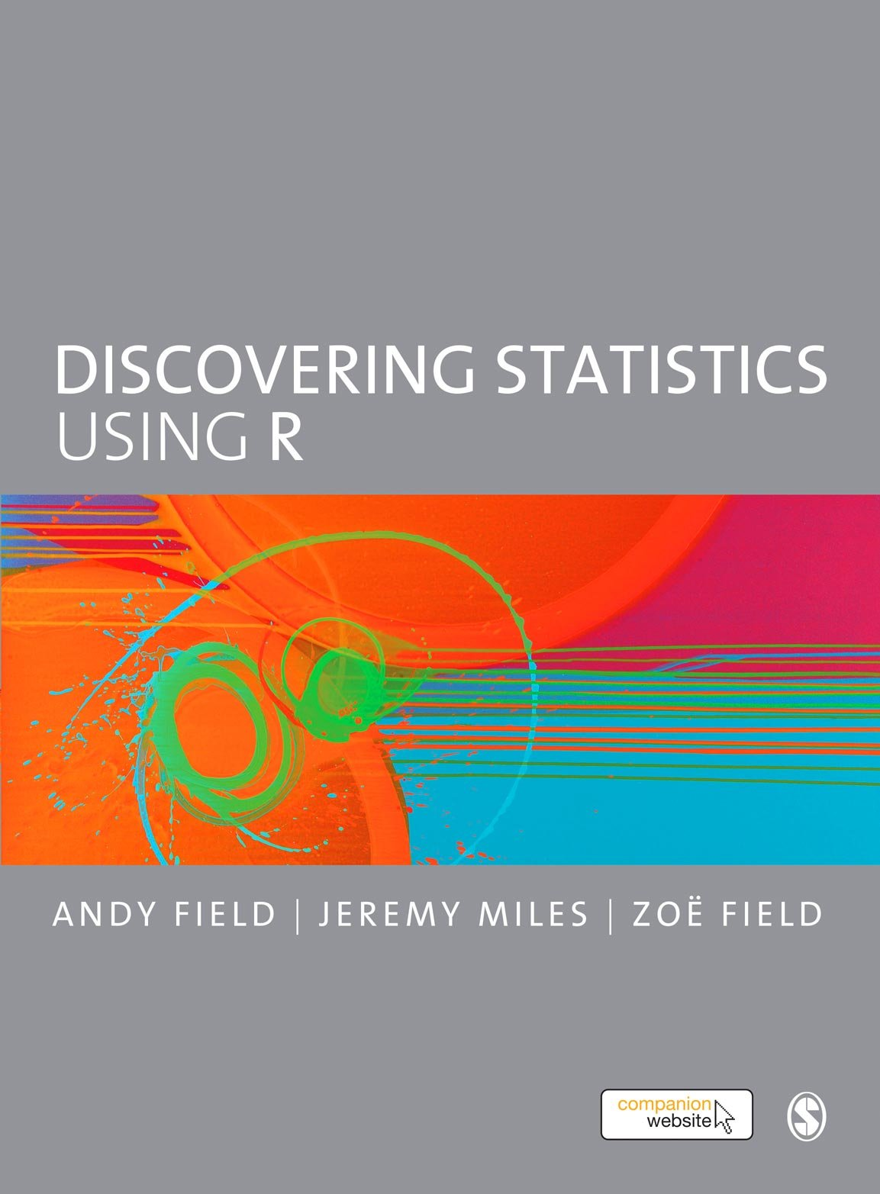
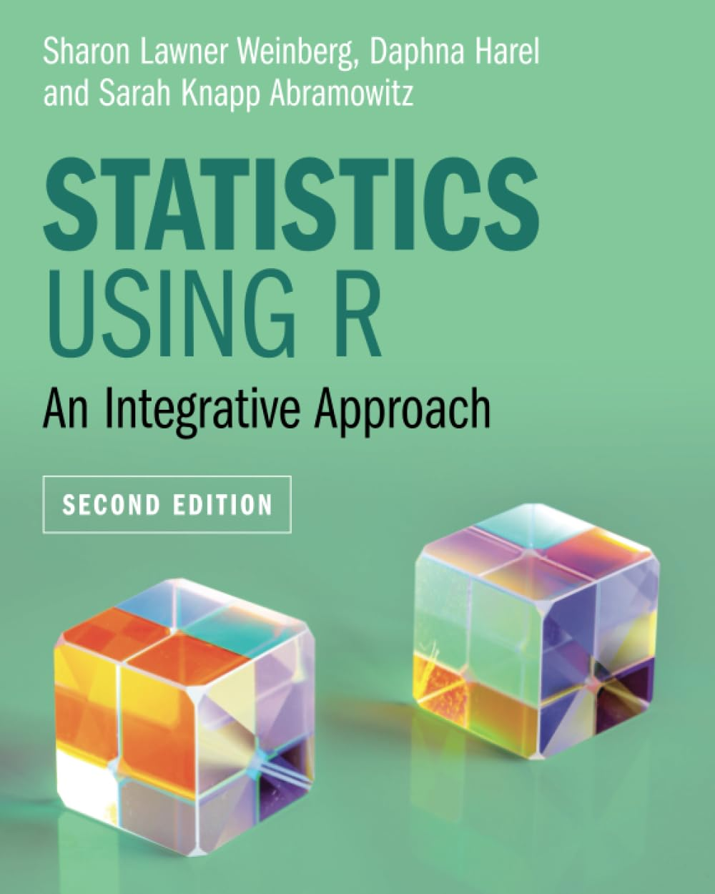
Some Recommended Textbooks

Slide 3

Data Visualizations

Slide 4
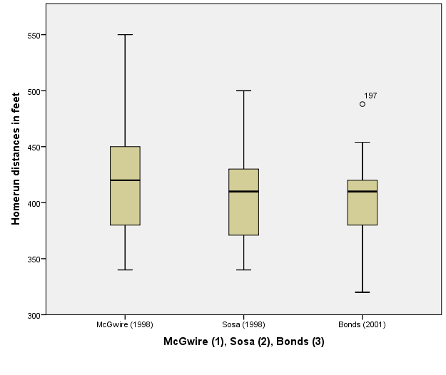
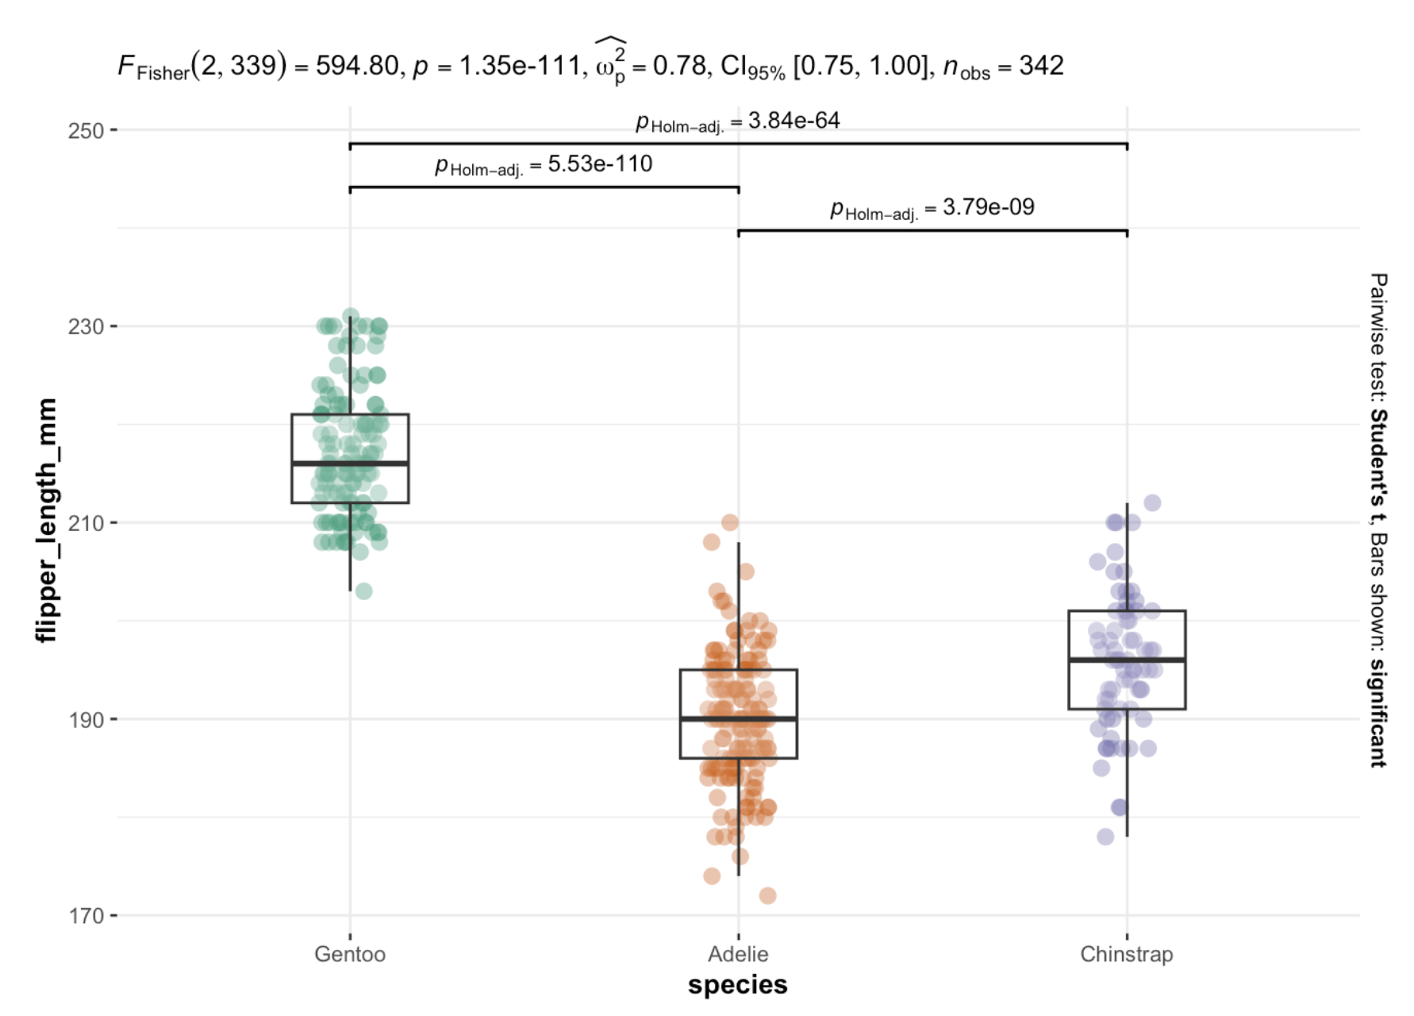
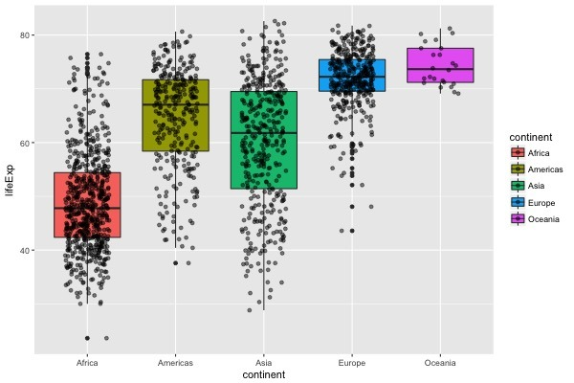
Why using R for data visualizations

Slide 5
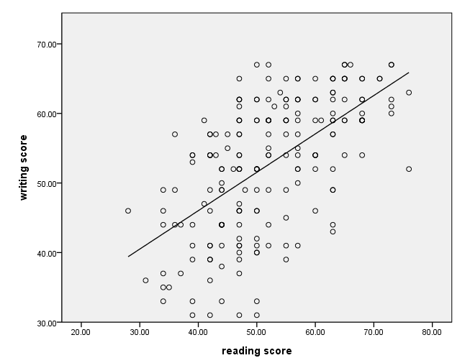
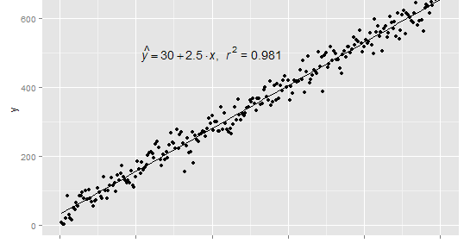
Why using R for data visualizations

Slide 6
Why using R for data visualizations
Advantages
More professional, more “beautiful” graphs
Flexibility to make subtle changes
Reproducibility of your research
Disadvantage
More “challenging” → requiring coding experiences
Notwithstanding, it’s a rewarding experience !!!

Slide 7
Let’s get started

Slide 8
Exploring One-dimensional, Univariate Distribution of Data

Slide 9
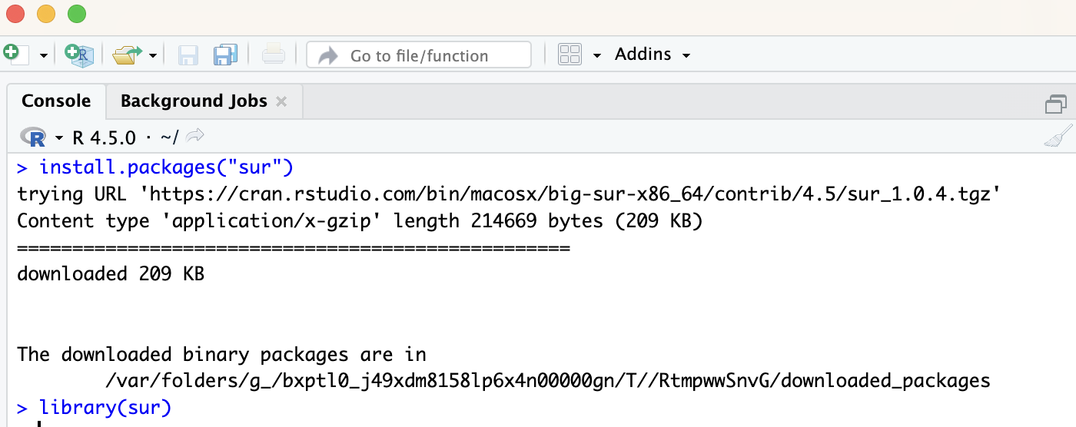
Installing “sur” package

Slide 10
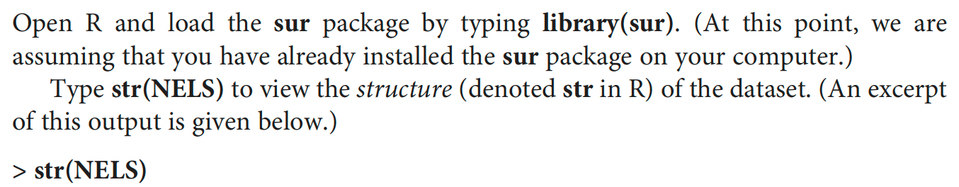
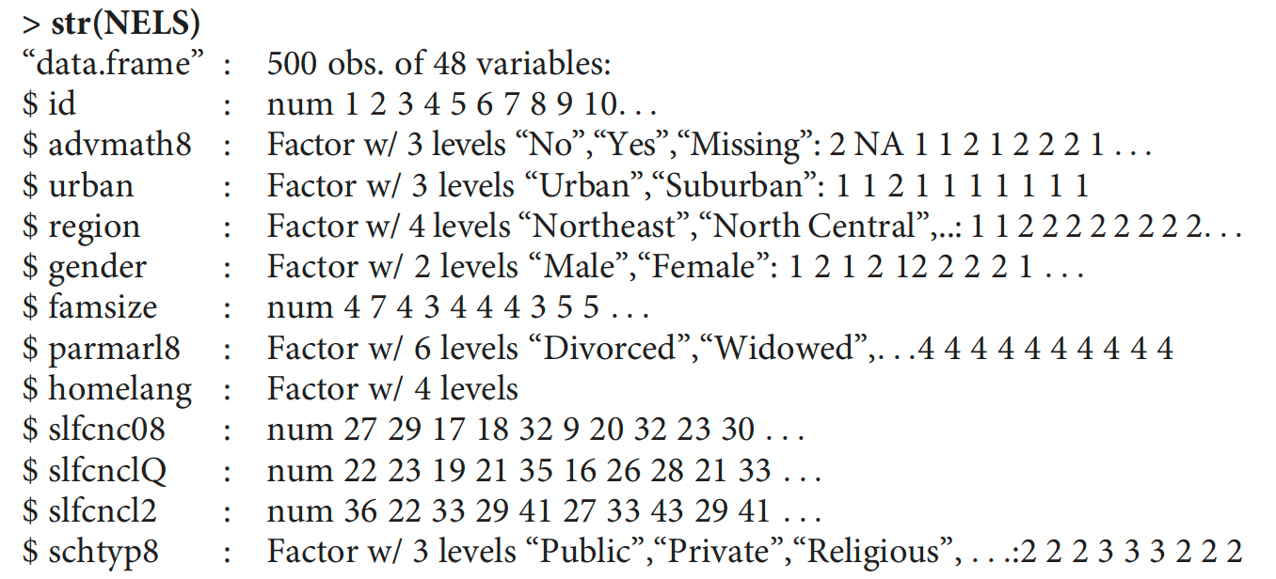
Inspecting the data structure

Slide 11
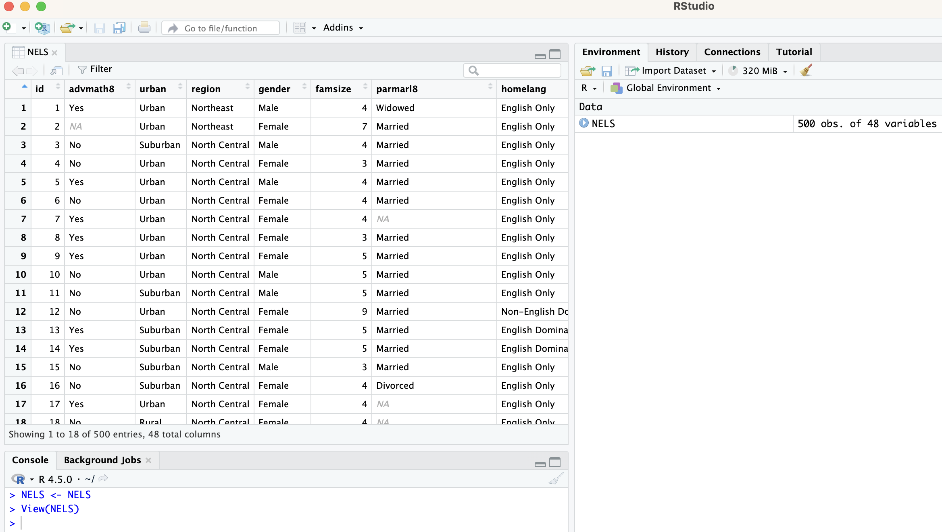
Inspecting the data structure

Slide 12
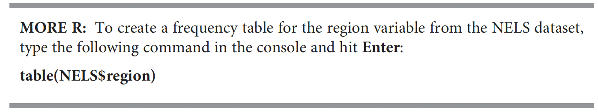
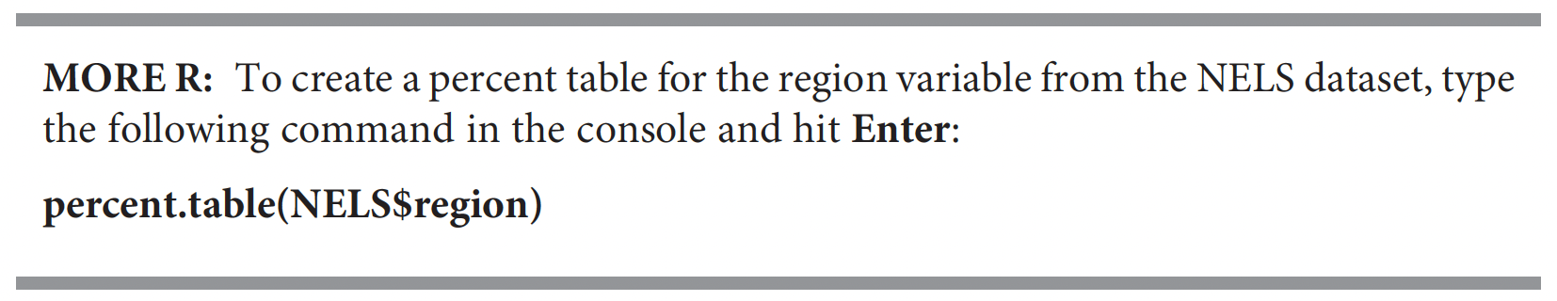
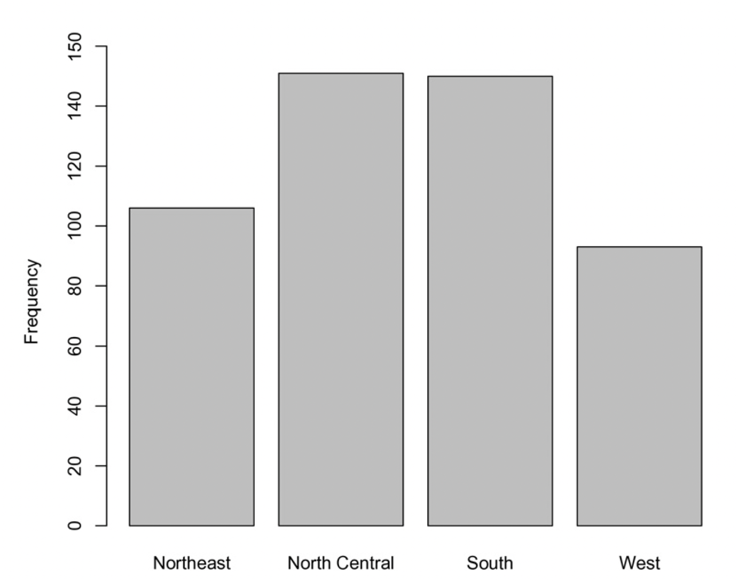
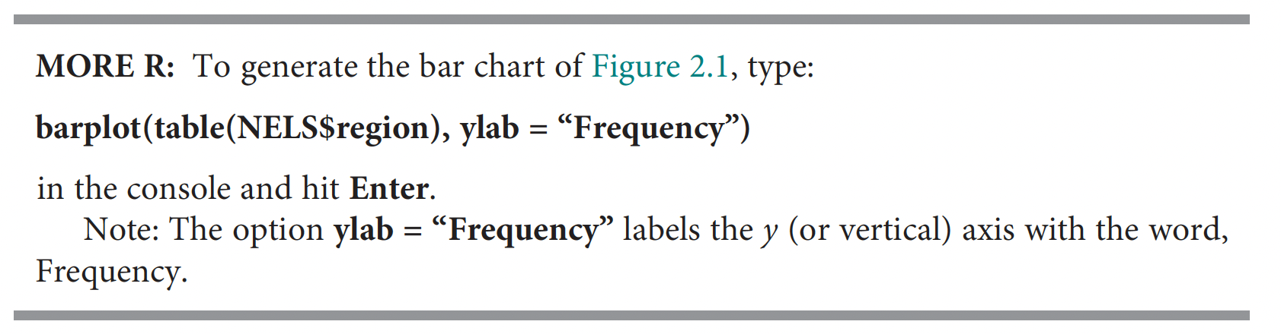
Examining Univariate Distributions - Bar plot

Slide 13
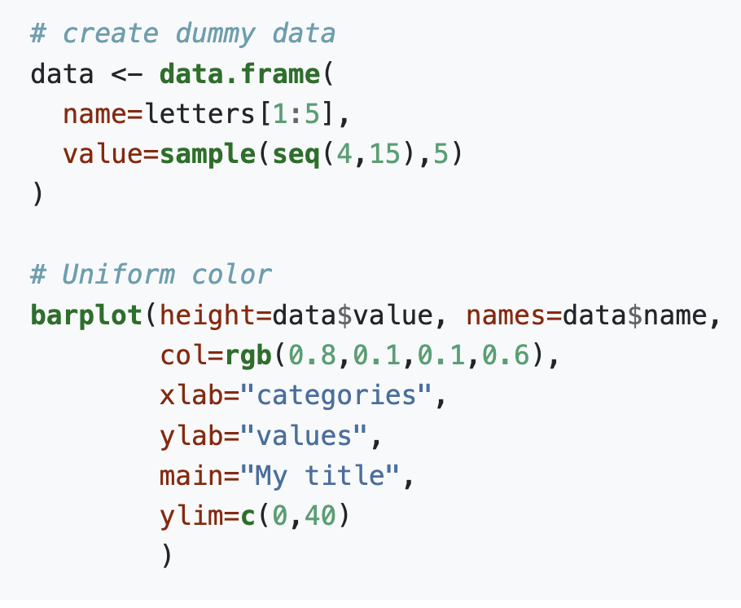
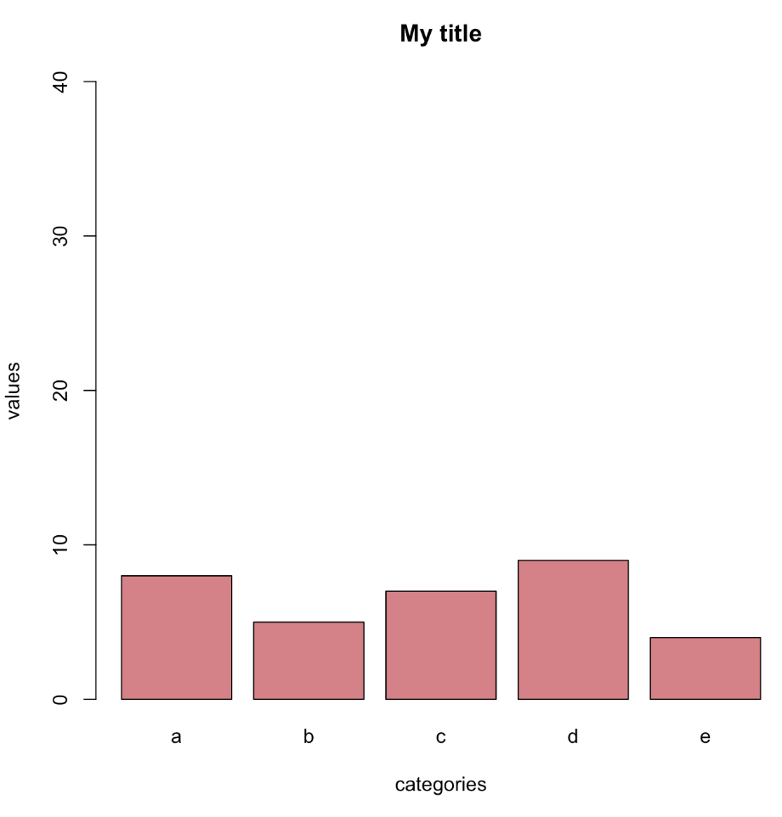
Examining Univariate Distributions – Bar Plot
Notes:
https://r-graph-gallery.com/209-the-options-of-barplot.html#title

Slide 14
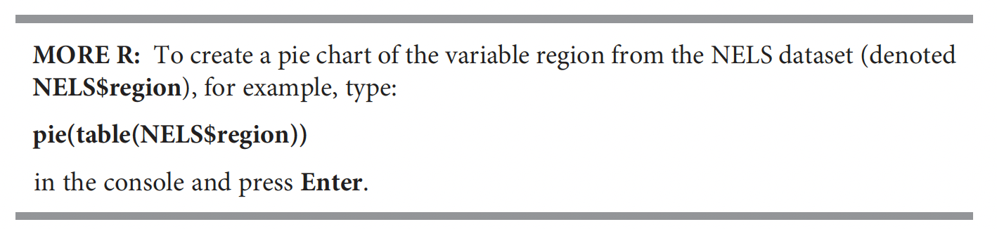
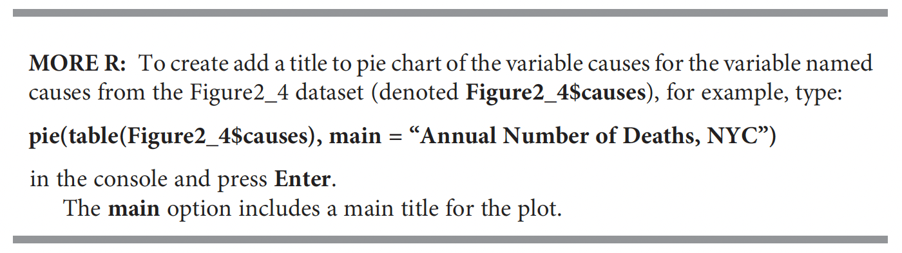
Examining Univariate Distributions – Pie chart

Slide 15
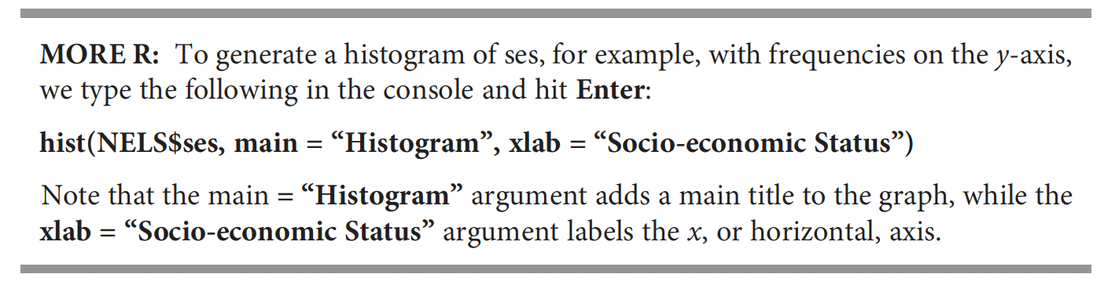
Examining Univariate Distributions – Histogram

Slide 16
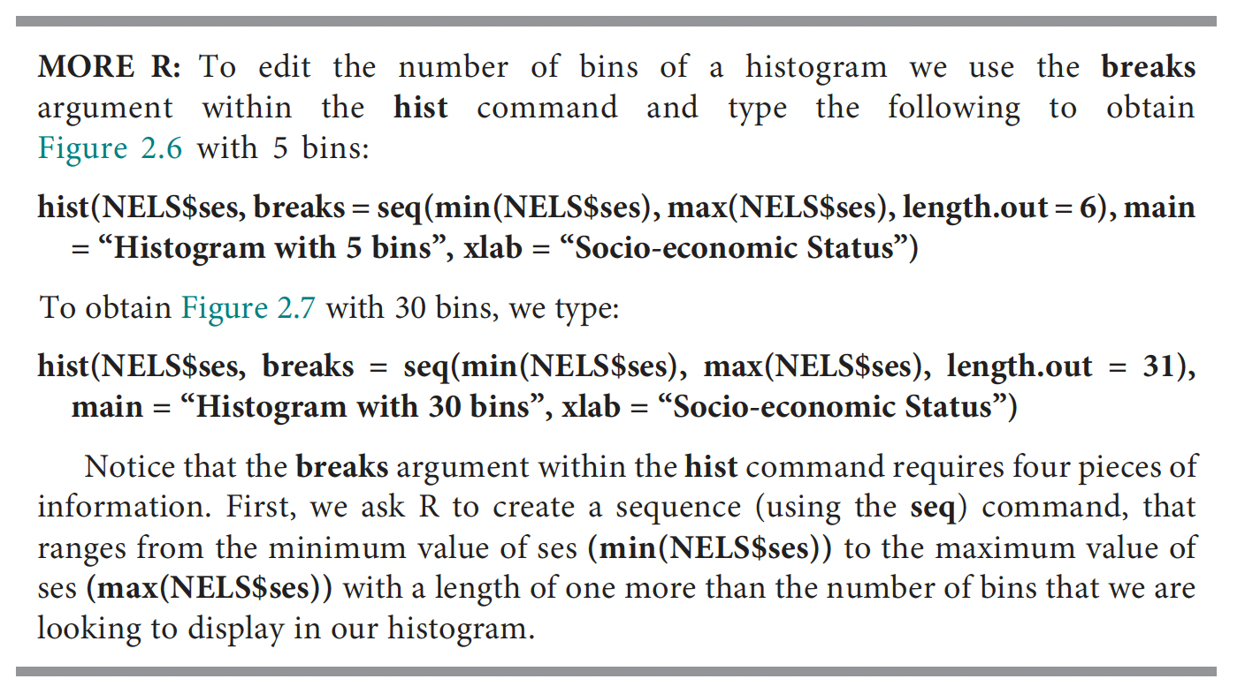
Examining Univariate Distributions – Histogram

Slide 17
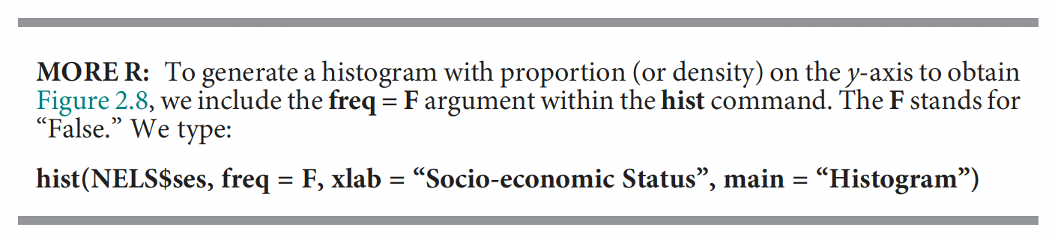
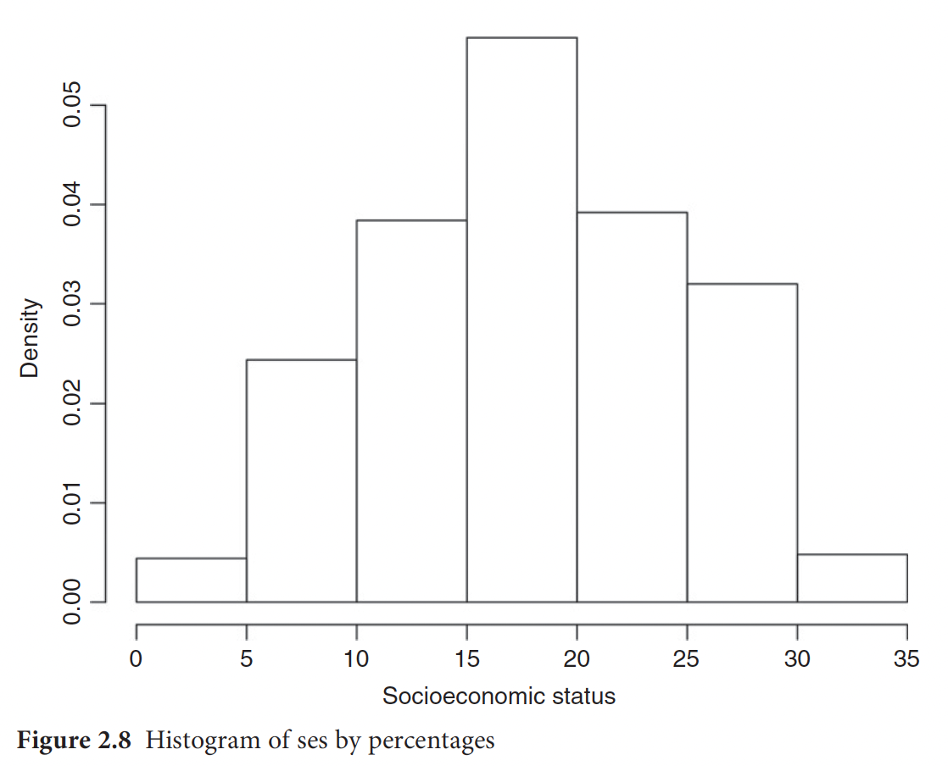
Examining Univariate Distributions – Histogram

Slide 18
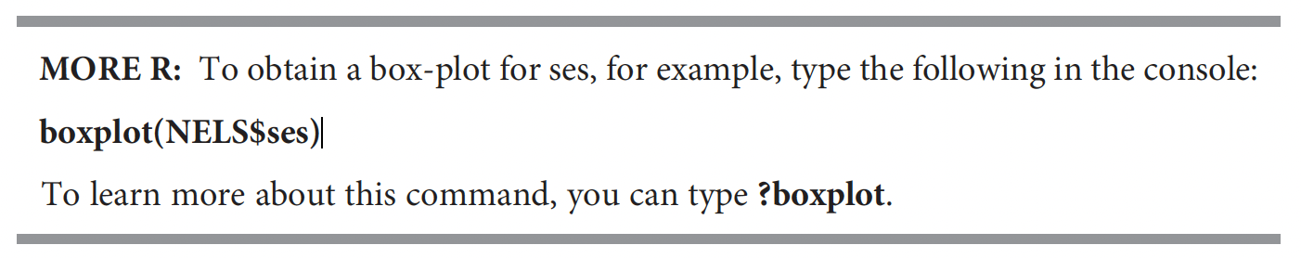
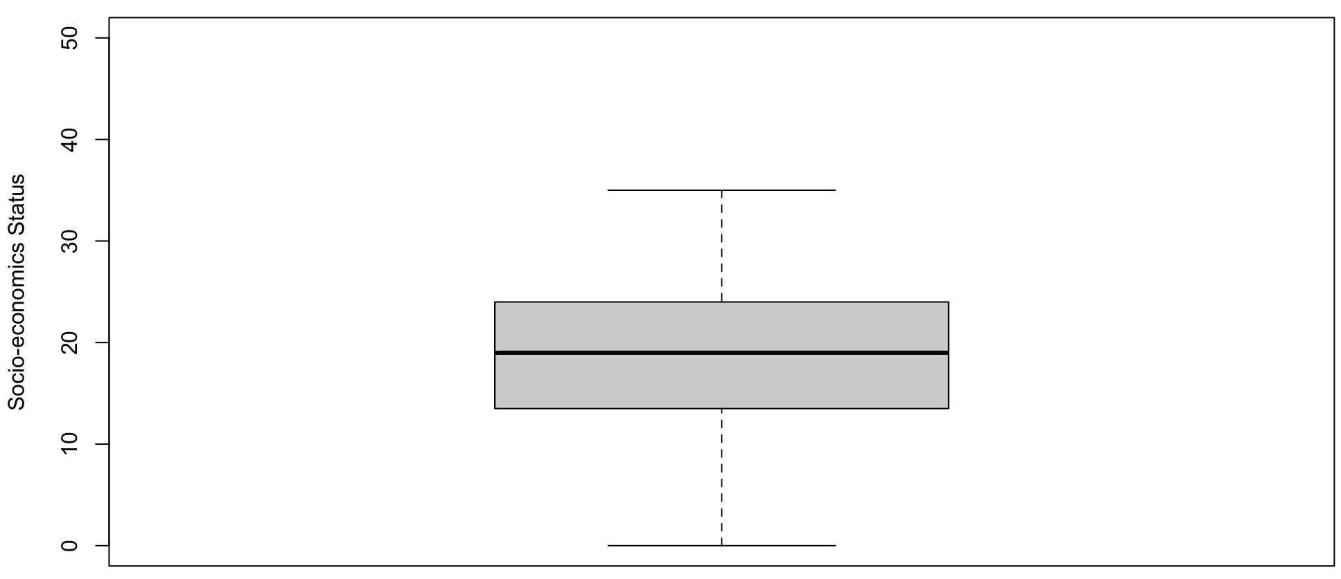
Examining Univariate Distributions – Boxplot

Slide 19
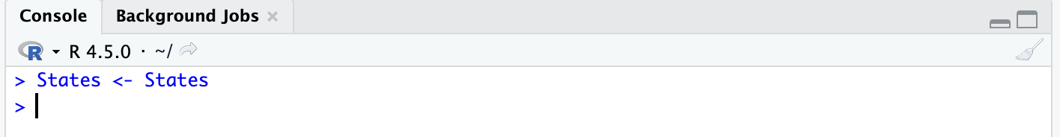
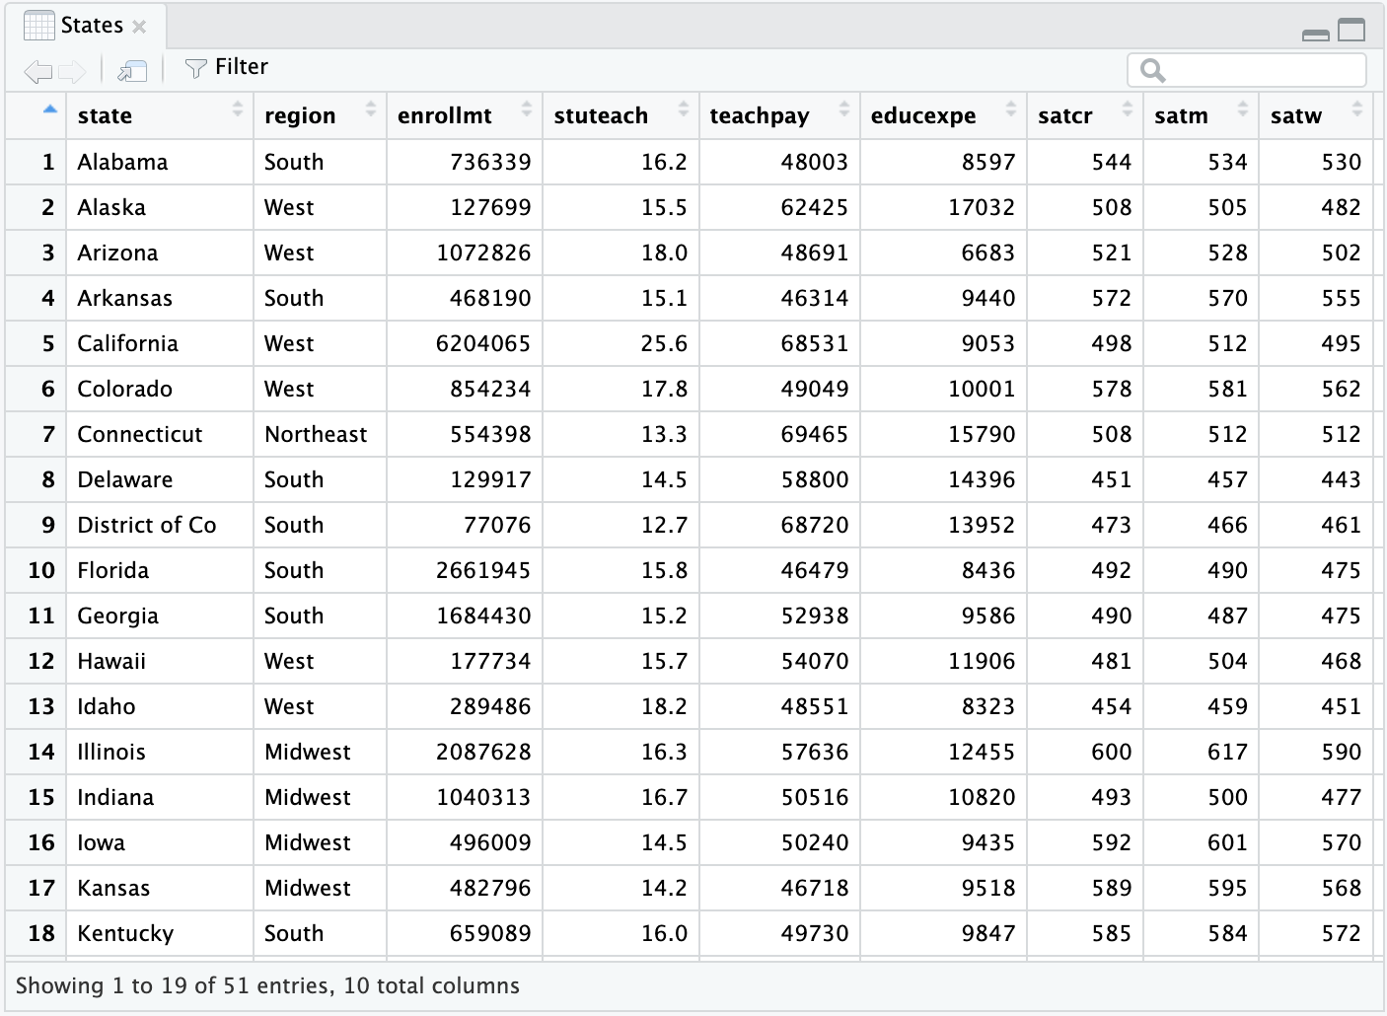
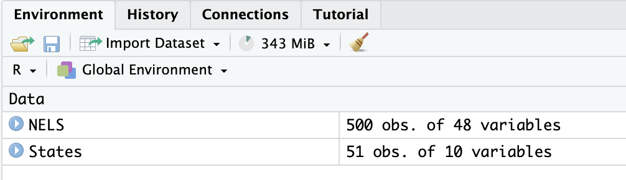
Examining Univariate Distributions – Boxplot

Slide 20
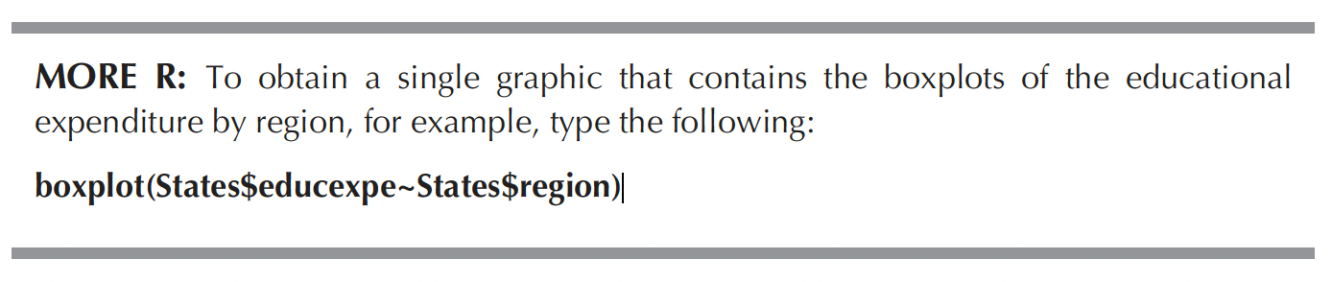
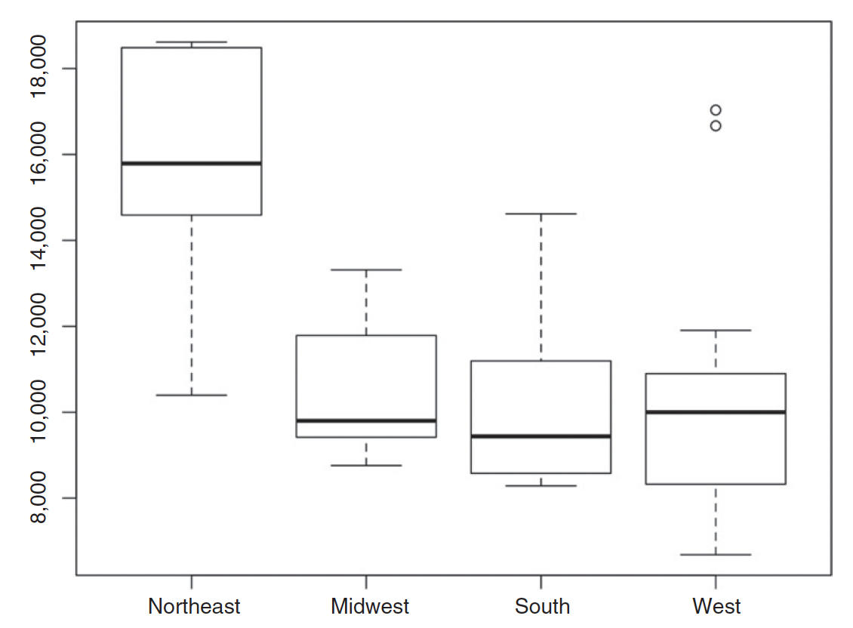
Examining Univariate Distributions – Boxplot

Slide 21
Now, we move on to exploration of relationships between TWO variables

Slide 22
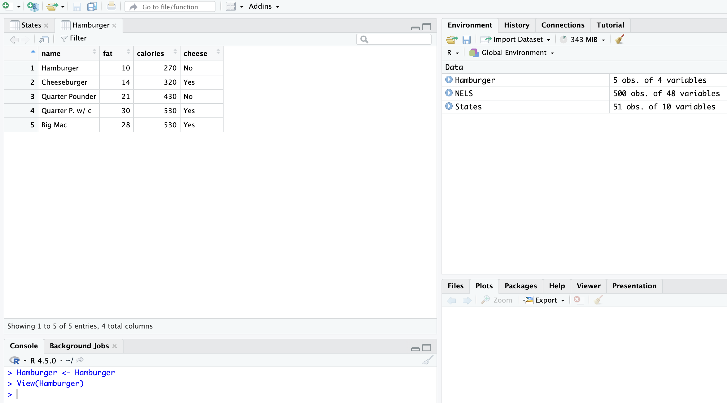
Examining Bivariate Associations
When both variables are interval-ratio levelled

Slide 23
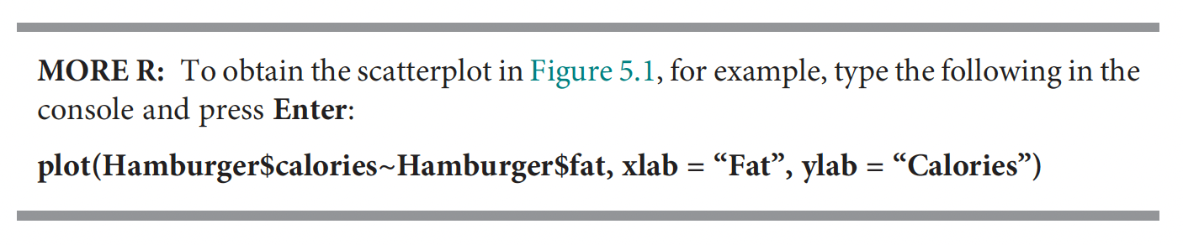
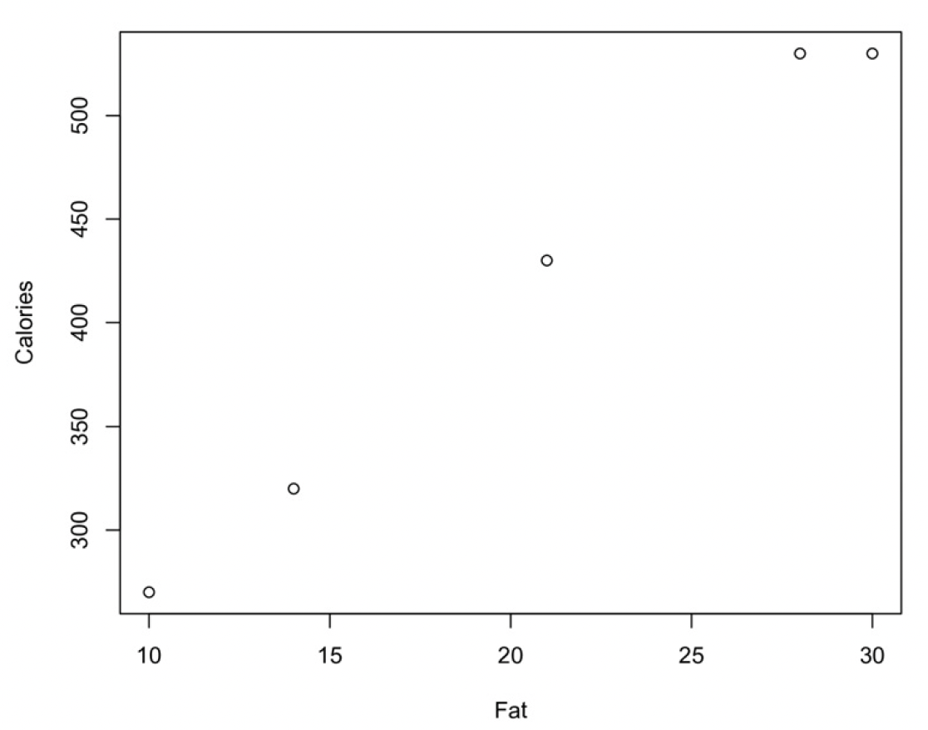
Examining Bivariate Associations - Scatterplot

Slide 24
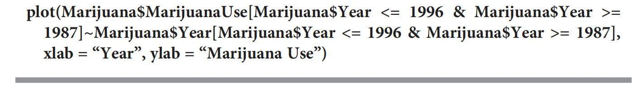
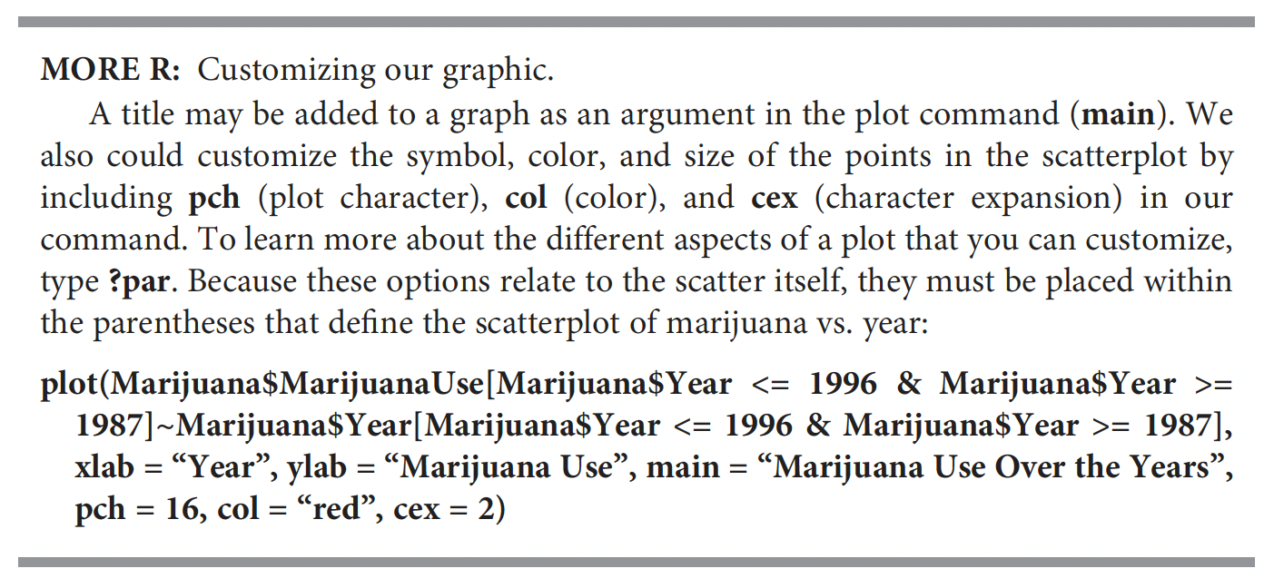
Examining Bivariate Associations - Scatterplot

Slide 25
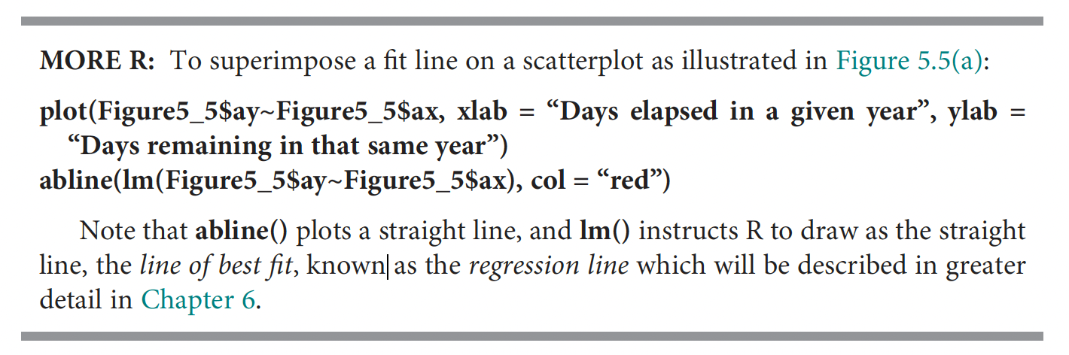
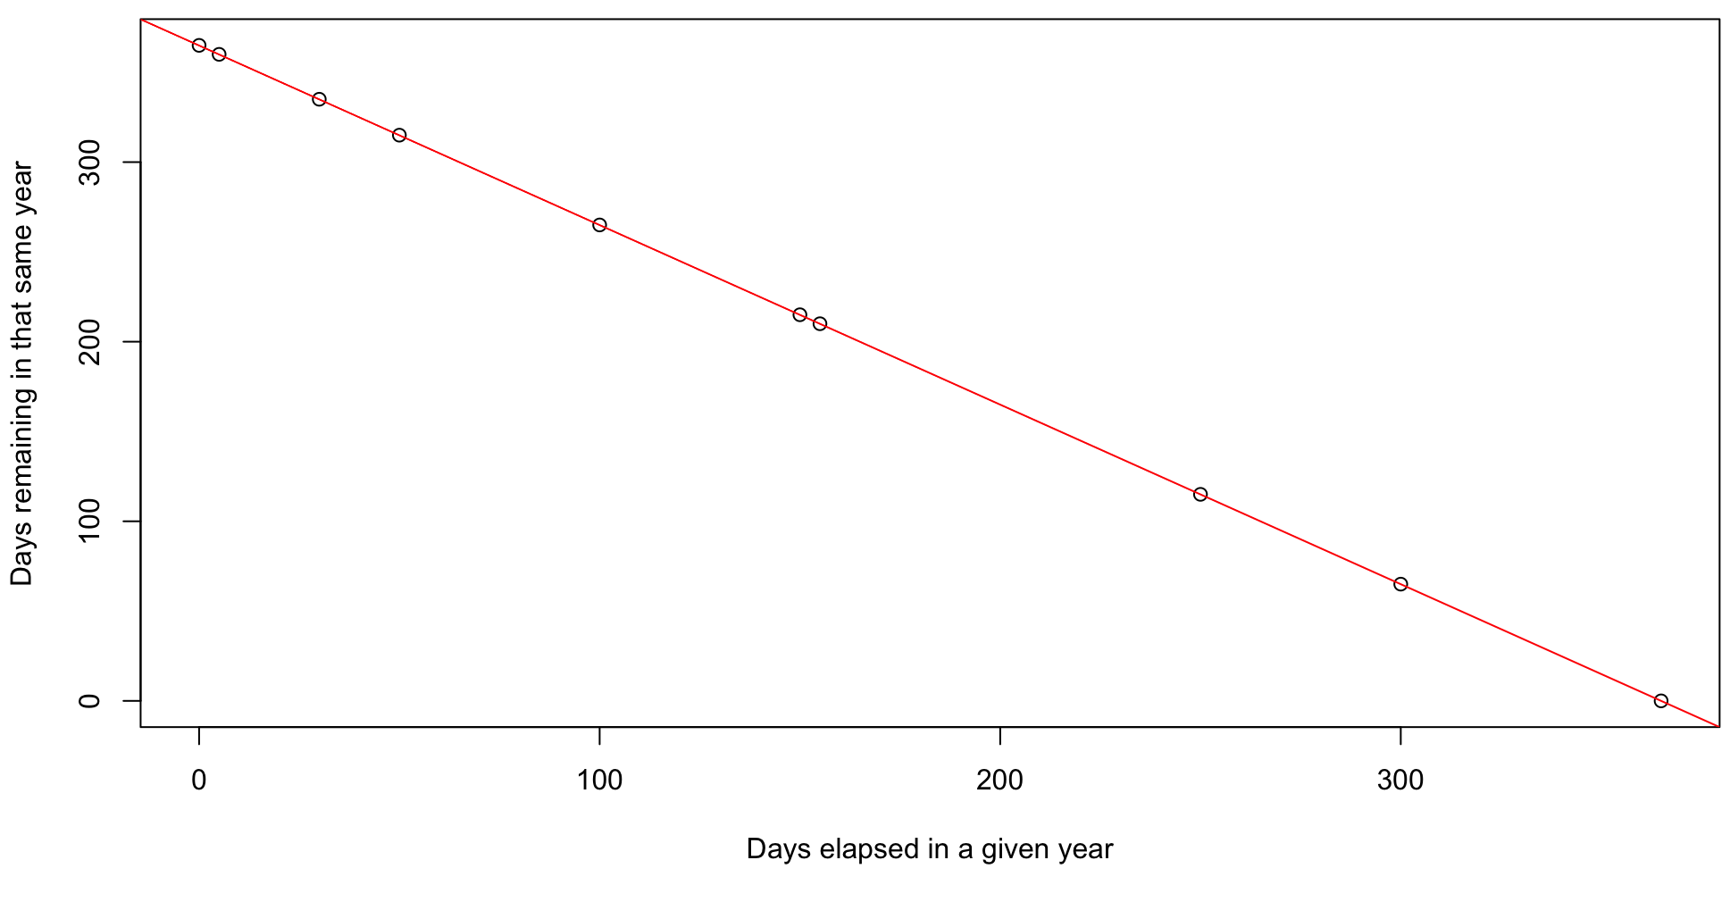
Examining Bivariate Associations - Scatterplot

Slide 26
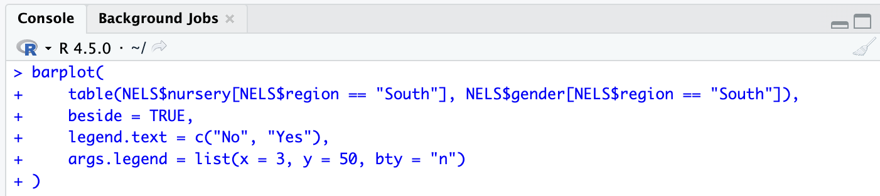
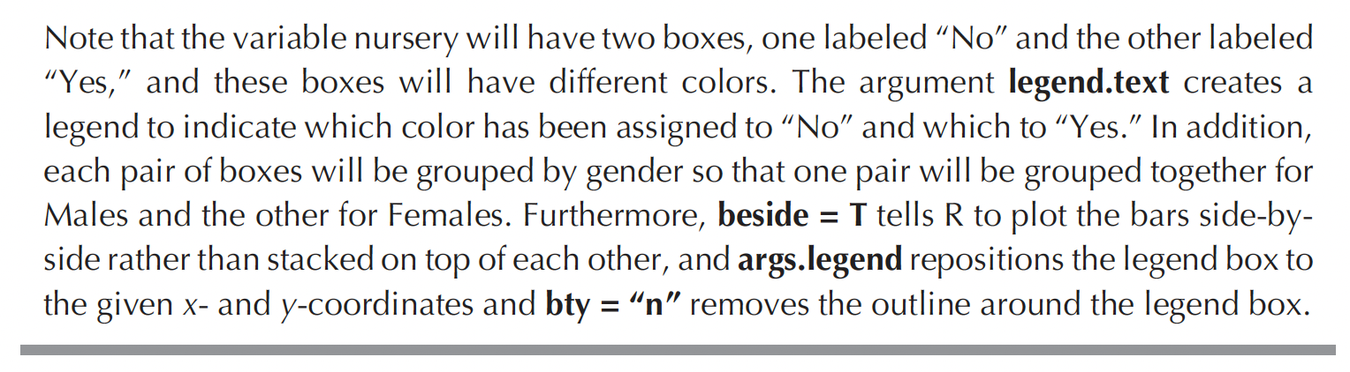
Examining Bivariate Associations – Cluster Bar Graph

Slide 27
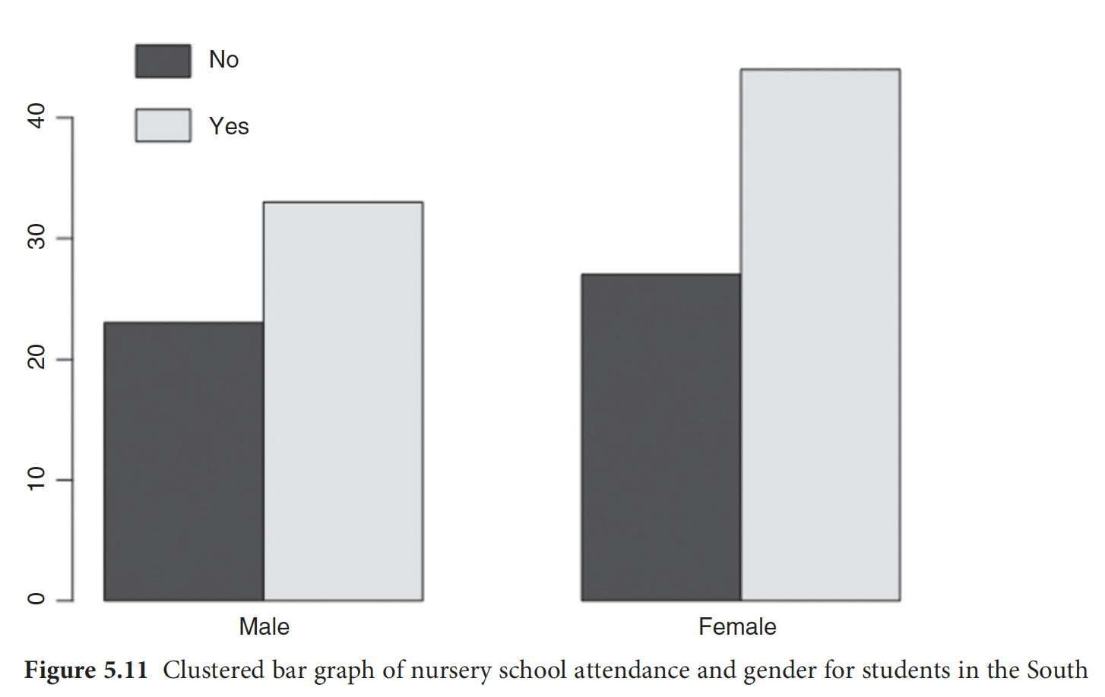
Examining Bivariate Associations – Cluster Bar Graph

Slide 28
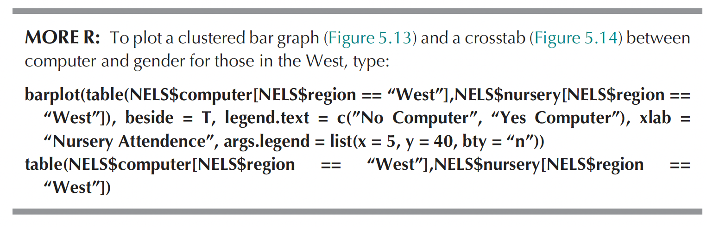
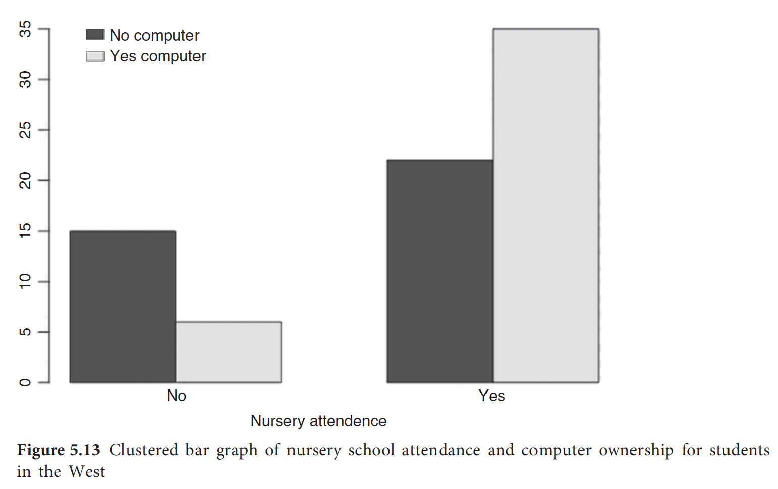
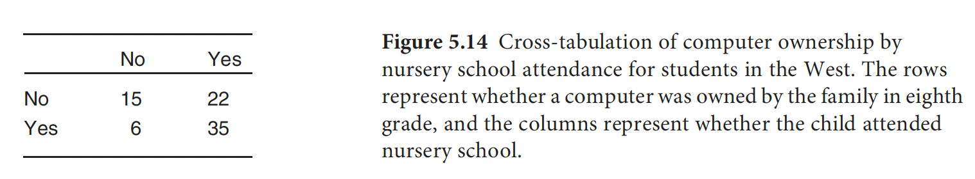
Examining Bivariate Associations – Cluster Bar Graph

Slide 29
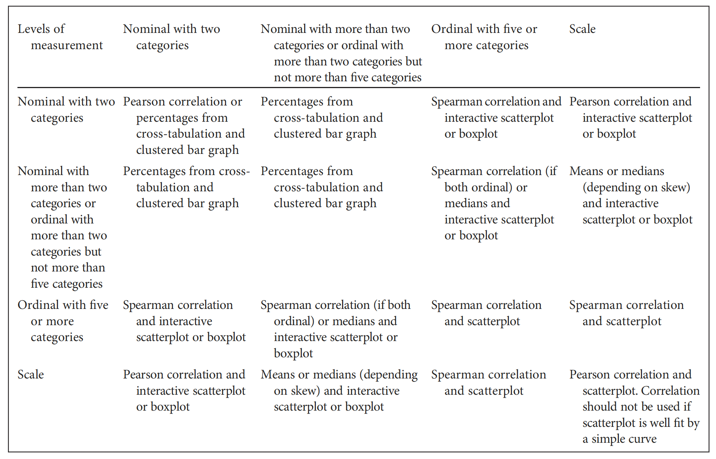
Examining Bivariate Associations – A quick wrap-up

Slide 30
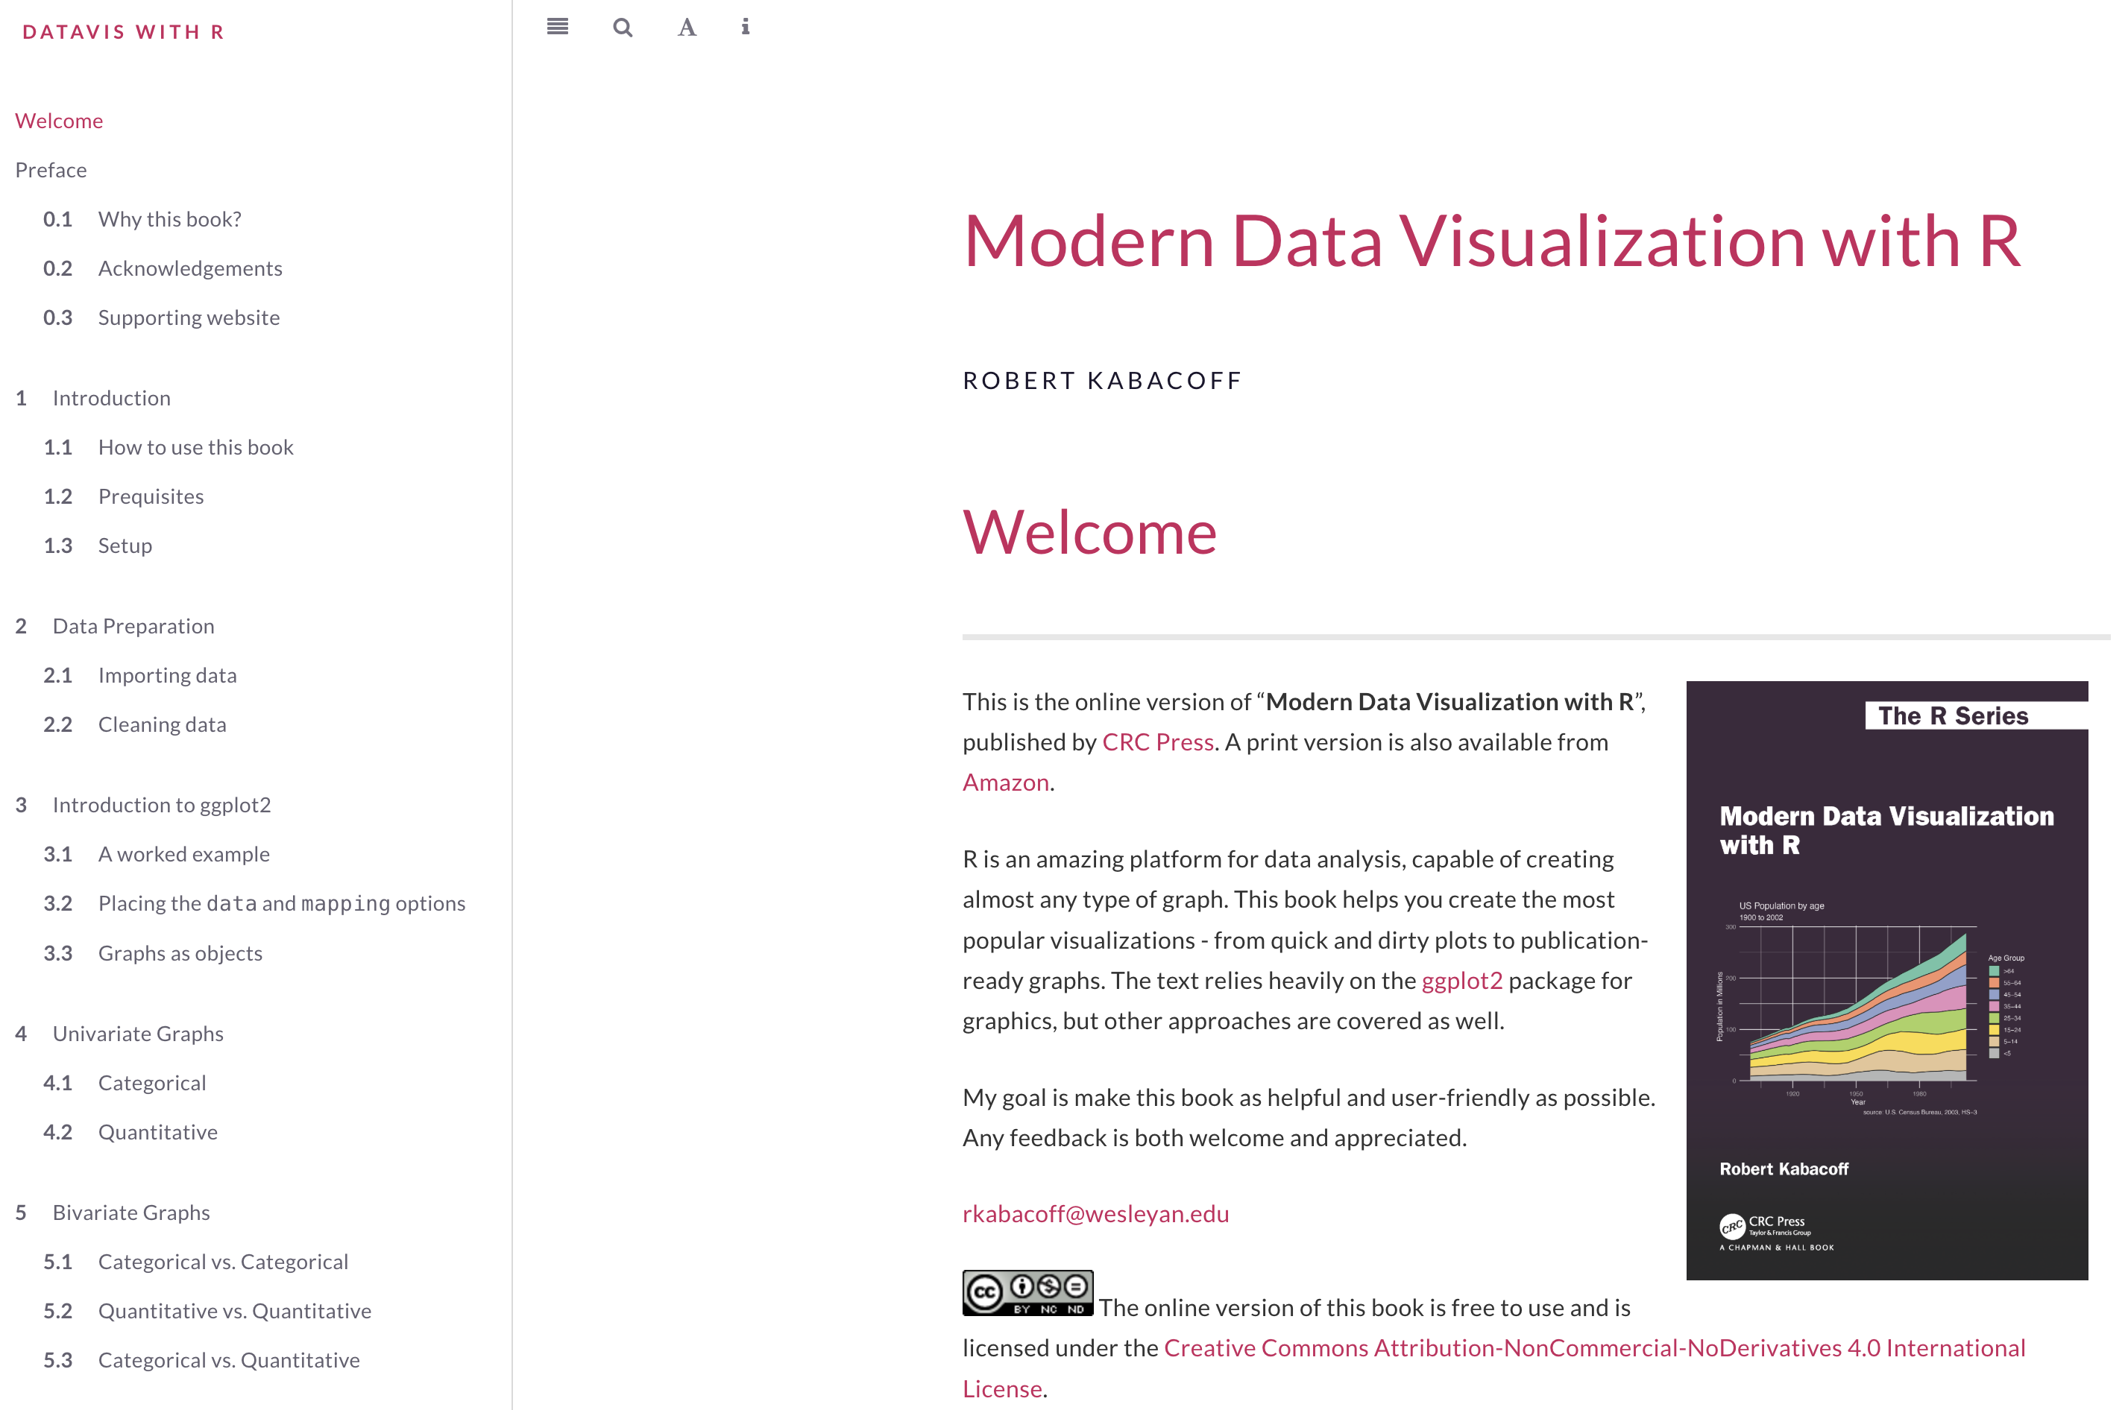
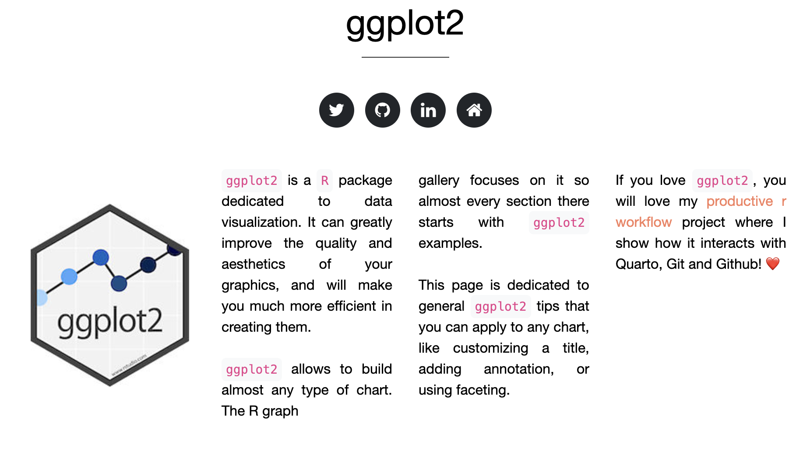
Examining Bivariate Associations – Further Resources
Notes:
https://rkabacoff.github.io/datavis/
https://r-graph-gallery.com/ggplot2-package.html

Slide 31
How about a 5-minute break?

Slide 32
Inferential Statistics

Slide 33
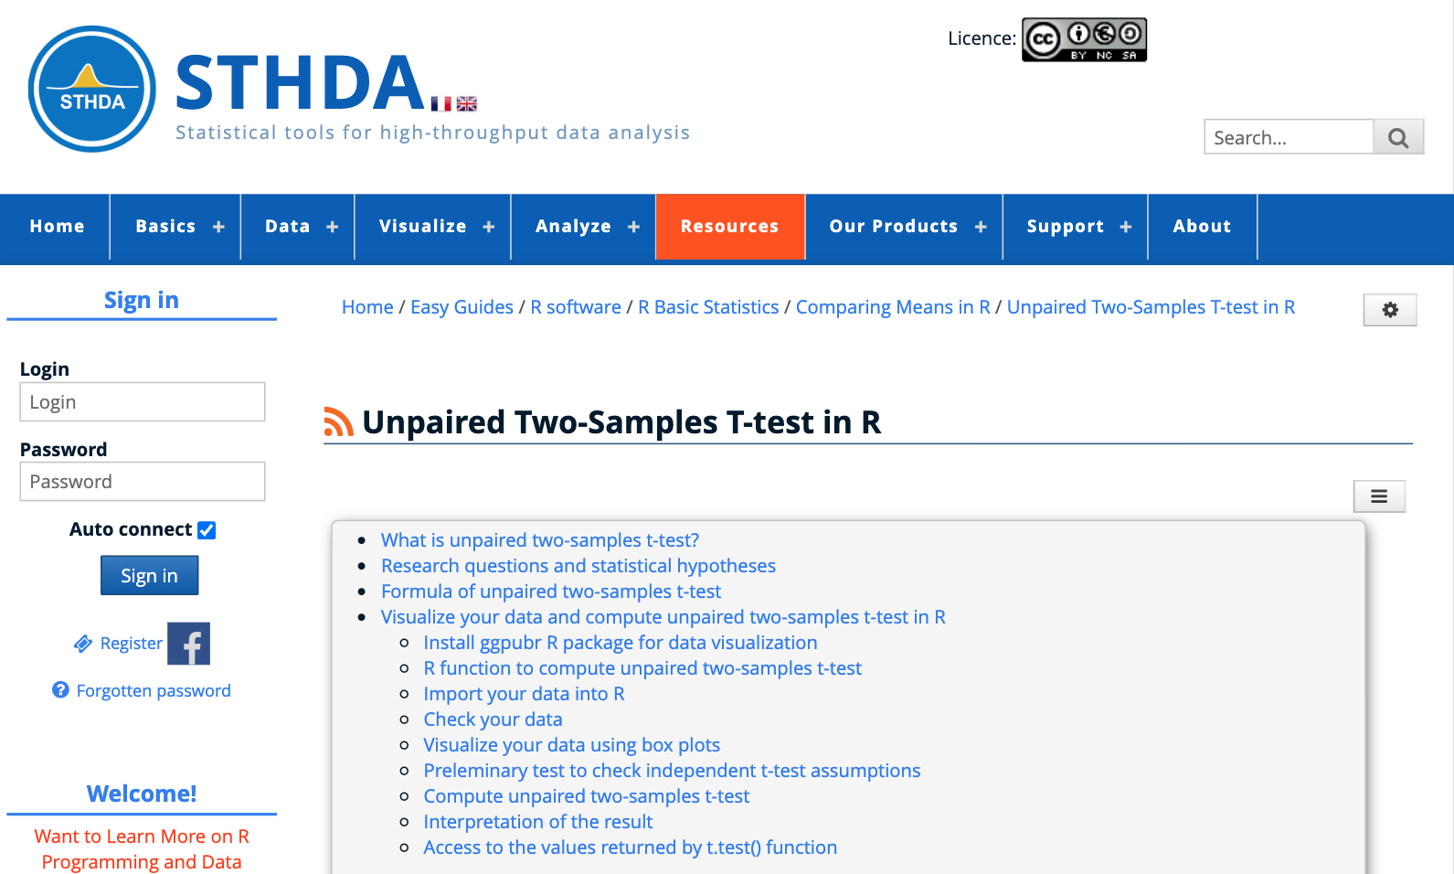
Independent-samples t test
Notes:
https://www.sthda.com/english/wiki/unpaired-two-samples-t-test-in-r?title=unpaired-two-samples-t-test-in-r

Slide 34
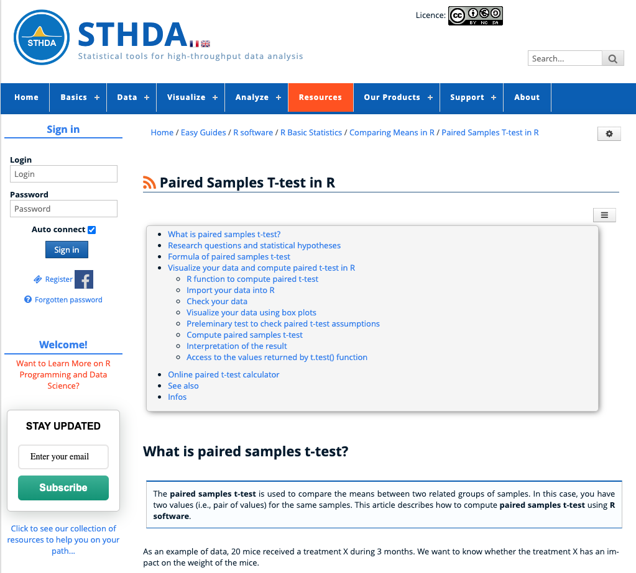
Paired-samples t test
Notes:
https://www.sthda.com/english/wiki/paired-samples-t-test-in-r

Slide 35
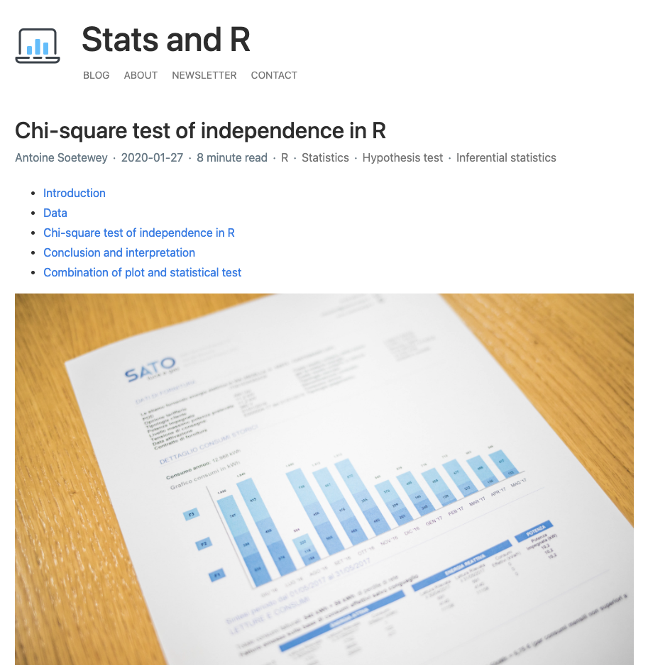
Chi-square test
Notes:
https://statsandr.com/blog/chi-square-test-of-independence-in-r/

Slide 36
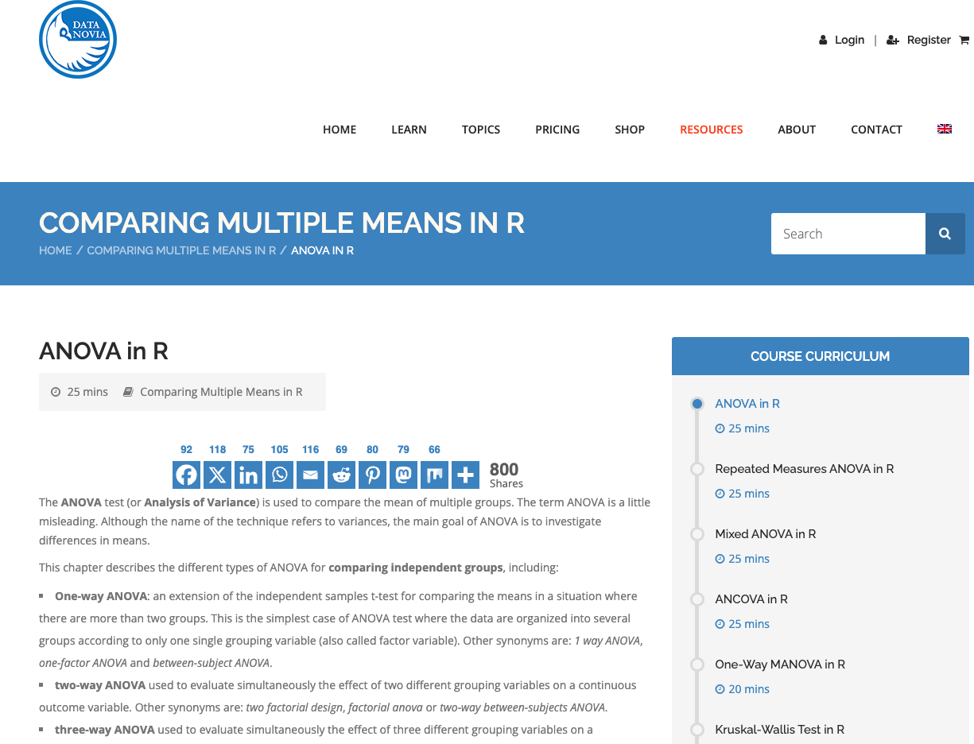
One-way ANOVA
Notes:
https://www.datanovia.com/en/lessons/anova-in-r/

Slide 37

One-way repeated measures ANOVA
Notes:
https://www.datanovia.com/en/lessons/repeated-measures-anova-in-r/

Slide 38

Mixed-ANOVA
Notes:
https://www.datanovia.com/en/lessons/mixed-anova-in-r/

Slide 39

Pearson’s Correlation
Notes:
https://www.sthda.com/english/wiki/correlation-matrix-a-quick-start-guide-to-analyze-format-and-visualize-a-correlation-matrix-using-r-software#compute-correlation-matrix

Slide 40

Linear Regression
Notes:
https://www.sthda.com/english/articles/40-regression-analysis/168-multiple-linear-regression-in-r/

Slide 41

Further Resources
Notes:
https://quantdev.ssri.psu.edu/

Slide 42

Further Resources
Notes:
https://stats.oarc.ucla.edu/other/mult-pkg/seminars/#R

Slide 43



Further Resources

Slide 44


